Slide 1


Slide 2
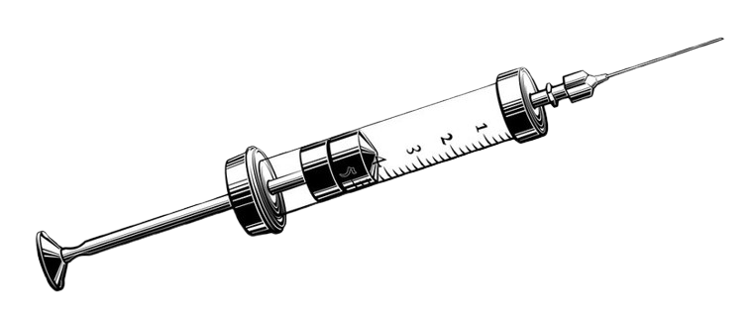
Dependency injection
Don't let dependencies drag you down. Inject them up!

Slide 3


Content
Intro
Manual DI implementation
Intro to Koin
Koin implementation
Best practices & common pitfalls
Alternatives
Conclusion

Slide 4
Intro

Slide 5
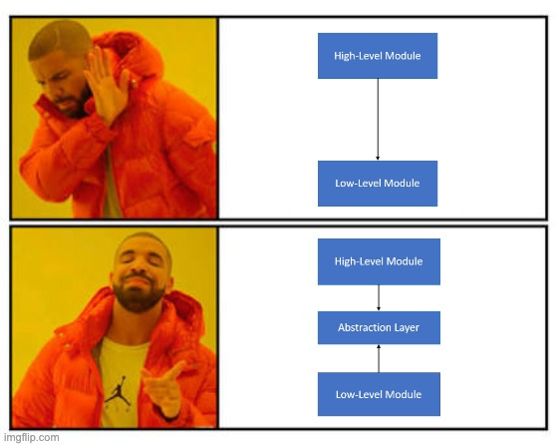
Intro
Dependency – direct relationship between two classes; i.e. one relies on another for its functionality
Dependency injection – implementation technique for populating instance variables of a class
Based onto Dependency Inversion Principle (SOLID) – high-level modules shouldn’t depend on low-level modules, both should depend on abstractions

Slide 6
Intro
4 roles of DI:
Service – class that carries some functionality
Client – class that requests something from a service
Interface – abstract component implemented by a service for use by one or more clients
Injector – component that introduces a service to a client; i.e. creating and inserting a service into a client
Types of injection:
Constructor injection (clear glance on required dependencies)
Public property/field injection
Method injection

Slide 7
Manual DI implementation

Slide 8

Manual DI implementation

Slide 9
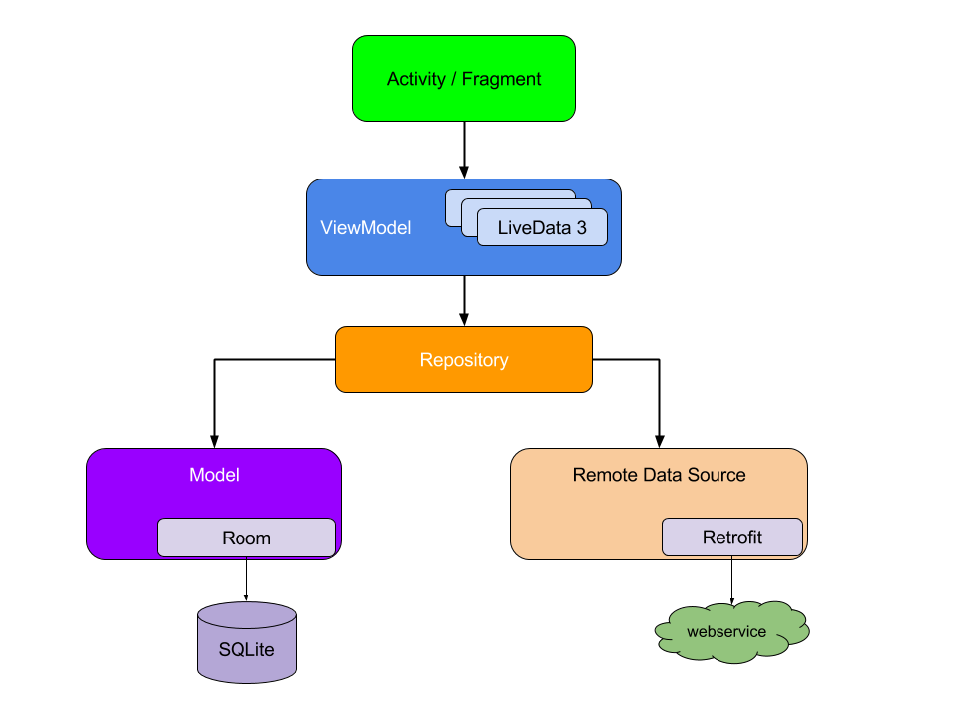
Manual DI implementation

Slide 10
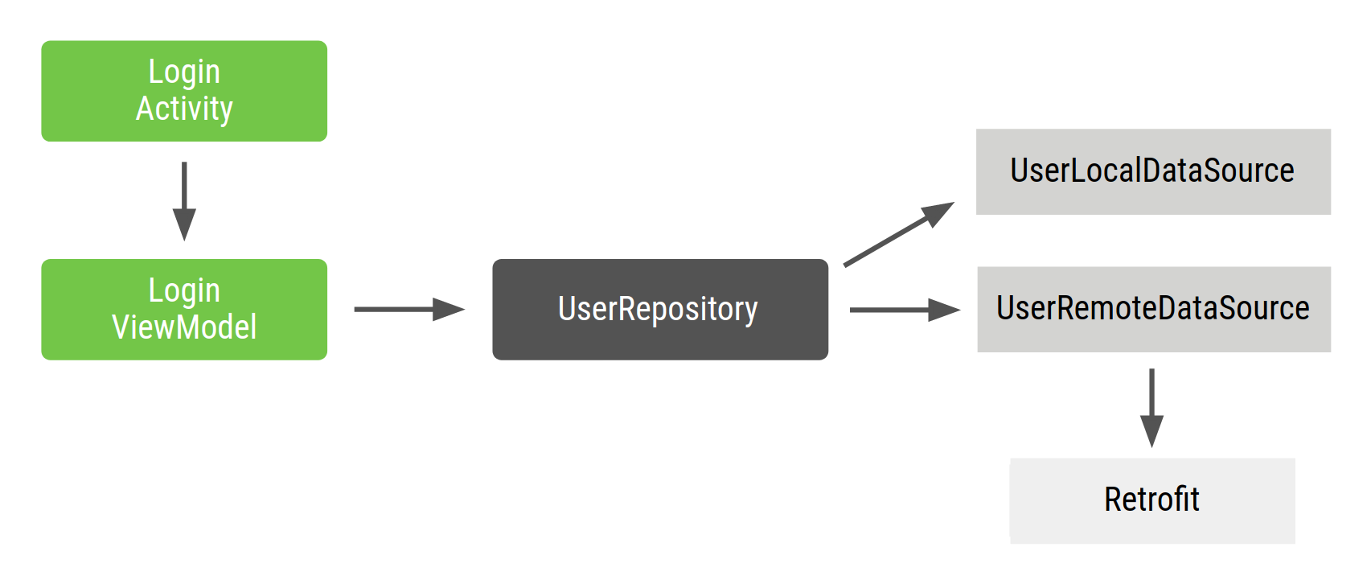
Manual DI implementation

Slide 11

class LoginViewModel( private val userRepository: UserRepository ) { ... }
class UserRepository( private val localDataSource: UserLocalDataSource, private val remoteDataSource: UserRemoteDataSource ) { ... } class UserLocalDataSource { ... } class UserRemoteDataSource( private val loginService: ExternalLoginService ) { ... }

Slide 12
class LoginActivity: Activity() { private lateinit var loginViewModel: LoginViewModel override fun onCreate(savedInstanceState: Bundle?) { super.onCreate(savedInstanceState) val loginService: ExternalLoginService() val remoteDataSource = UserRemoteDataSource(loginService) val localDataSource = UserLocalDataSource() val userRepository = UserRepository(localDataSource, remoteDataSource) loginViewModel = LoginViewModel(userRepository) } }

Slide 13

Why this sucks?
Lot of boilerplate code – duplication of the same code pattern for each feature or screen
Dependencies have to be declared in order – you can’t instantiate a ViewModel object before Repository object
Difficult to reuse object – to share Repository across multiple features you need to construct the Repository following the singleton pattern (deprecated) + makes testing more difficult because all tests share the same singleton instance

Slide 14
There are ways to improve it
Manage dependencies with a dependency container
Implement factory pattern for instantiation of multiple objects of the same type – example: you need a viewmodel in more places in the app
Use an DI framework to simplify your development

Slide 15
interface Factory<T> { fun create(): T } class LoginViewModelFactory(private val userRepository: UserRepository) : Factory { override fun create(): LoginViewModel = LoginViewModel(userRepository) }
class AppContainer { private val loginService = ExternalLoginService() private val remoteDataSource = UserRemoteDataSource(loginService) private val localDataSource = UserLocalDataSource() private val userRepository = UserRepository(localDataSource, remoteDataSource)
// only VM factory gets exposed
val loginViewModelFactory = LoginViewModelFactory(userRepository) }

Slide 16
// Custom Application class that needs to be specified in the AndroidManifest.xml file class MyApplication : Application() { val appContainer = AppContainer() }
class LoginActivity: Activity() { private lateinit var loginViewModel: LoginViewModel override fun onCreate(savedInstanceState: Bundle?) { super.onCreate(savedInstanceState) val appContainer = (application as MyApplication).appContainer loginViewModel = appContainer.loginViewModelFactory.create() } }

Slide 17

Drawbacks for this approach
AppContainer quickly gets complicated when you want to include more functionality into your app
Optimizing the AppContainer can be difficult and tiring – deleting or updating the whole dependency chain
Resulting into harder maintenance, reduced testability, larger time consumption on boilerplate code, error-prone, limited flexibility, depression and lack of motivation for developing

Slide 18
Intro to Koin

Slide 19
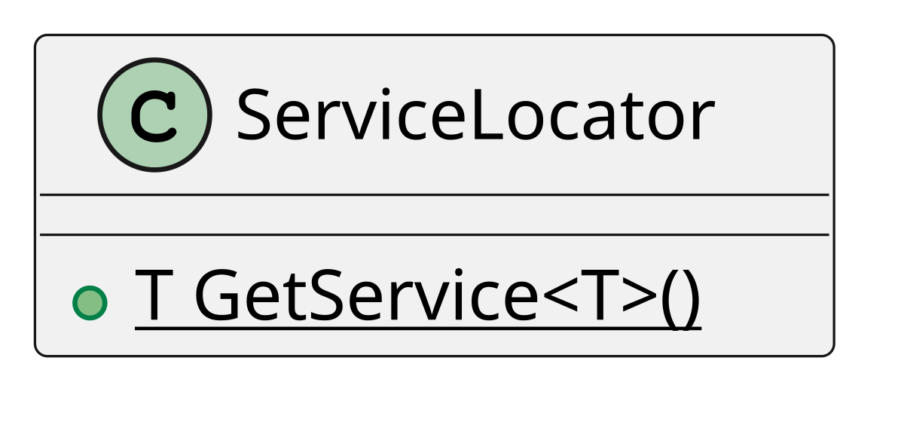
Intro to Koin
DI framework which uses Kotlin DSL (Domain Specific Language) with declarative approach
Popular because of its simplicity and support for Kotlin Multiplatform
Latest stable version: v4.0.1
Similar to service locator pattern (registry of available services ready to be requested for usage) but there are differences:
Koin defines its own modules instead of a single static registry
Dependencies are tightly coupled to the locator, Koin uses loose coupling due to modules and constructor injection

Slide 20
Koin terminology
Module - a container for defining dependencies and their relationships
Definition - a declaration of a dependency within a module. Definitions specify how to create or retrieve an instance of a particular type
Scope - a mechanism for controlling the lifecycle of dependencies
single – singleton dependency (one instance across the application)
factory - a factory dependency, meaning a new instance is created each time it's requested
viewModel - a ViewModelScope instance for managing the lifecycle of coroutines within a ViewModel
get() – resolves dependencies inside module
inject() – retrieving dependency instances from a module
Qualifier – name of the definition, differentiation between definitions of the same type

Slide 21
Koin implementation

Slide 22
Add Koin to project
dependencies {
// ... val koinVersion = ”4.0.1”
// Koin core features implementation("org.koin:koin-core:$koinVersion") // Koin Android features implementation("org.koin:koin-android:$koinVersion") implementation("org.koin:koin-androidx-viewmodel:$koinVersion")
// ...
}

Slide 23
Define modules and dependencies
val networkingModule = module { single<ProfileApi>(qualifier = named("PrimaryProfileApi")) { PrimaryProfileApiImpl() } single<ProfileApi>(qualifier = named("OtherProfileApi")) { OtherProfileApiImpl() } //... } val repositoryModule = module { single<ProfileRepository> { ProfileRepositoryImpl(api = get(qualifier = named("PrimaryProfileApi"))) } //... } val viewModelModule = module { viewModel<ProfileViewModel> { (profileId) ->
ProfileViewModelImpl(repository = get(), profileId = profileId)
} //... }

Slide 24
Initialize Koin
class MyApplication : Application() { override fun onCreate() { super.onCreate() startKoin { androidContext(this@MyApplication) modules(networkingModule, repositoryModule, viewModelModule) } } }
// Inside Manifest.xml
<manifest> <application android:name=".MyApplication” … />
</manifest>

Slide 25
Components injection
// Injection into Fragments or other classes
val vm by viewModel<ProfileViewModel> { parametersOf(profileId) }
val someService by inject<ProfileTranslator>()
// Injection into Composables
@Composable fun App() { val vm = koinViewModel<ProfileViewModel>() // lazy initialization is not possible in composables
val someService = koinInject<ProfileTranslator>()
//… } @Composable fun App(vm : ProfileViewModel = koinViewModel(), someService: ProfileTranslator = koinInject()) {
//… }

Slide 26
Practical example
Waiting for Android Studio to load up

Slide 27
Best practices & common pitfalls

Slide 28
Best practices & common pitfalls
Best practices:
Separate responsibilities – organize dependencies into layered modules (feature or functionality based)
Write clear unidirectional dependencies – avoid circular references
Use property injection with lazy injection technique where possible
Common pitfalls:
Incorrect scoping - overuse of Singletons
Tight Coupling
Unclear Module Structure

Slide 29
Alternatives

Slide 30
Alternatives
Dagger – relies on compile-time code generation, processes annotations during compilation to generate the DI code for object instantiation and injection
Hilt – built on top of Dagger with more simplified and Android-oriented (pre-defined) annotations

Slide 31
Alternatives comparison
Feature | Koin | Dagger | Hilt
Approach | Runtime service locator | Compile-time code generation | Inherits from Dagger
Learning curve | Easy | Steep | Moderate
Boilerplate code | Minimal | High | Medium
Setup | Simple, declarative | Complex (requires component definitions) | Simplified setup than Dagger (predefined components and scopes)
Compile time | None | Increases (can be significant) | Increases (less than Dagger)
Debugging | Easier | Complex (code generation) | Easier than Dagger

Slide 32
Conclusion

Slide 33
Conclusion
Dependency Injection promotes loose coupling, testability, and maintainability in your app
Relying on interfaces makes your code clean 🧹
Smaller or bigger project, Koin does the job 💪
If you are not familiar with SOLID principles, check it out 👀

Slide 34

Literature

Slide 35

Thanks! :]
Questions?
Martin Zagoršćak
Android & KM dev @ Endava
@martin.zagorscak

Slide 36
Homework
Implement DI system into your existing projects by following best practices.
Bonus: Study how Hilt works and try it out.

